Slide 1
Forwarding

Slide 2

Note
In classless addressing, we need at least four columns in a routing table.

Slide 3
Example 22.1
Make a routing table for router R1, using the configuration in Figure 22.6.
Solution
Table 22.1 shows the corresponding table.

Slide 4
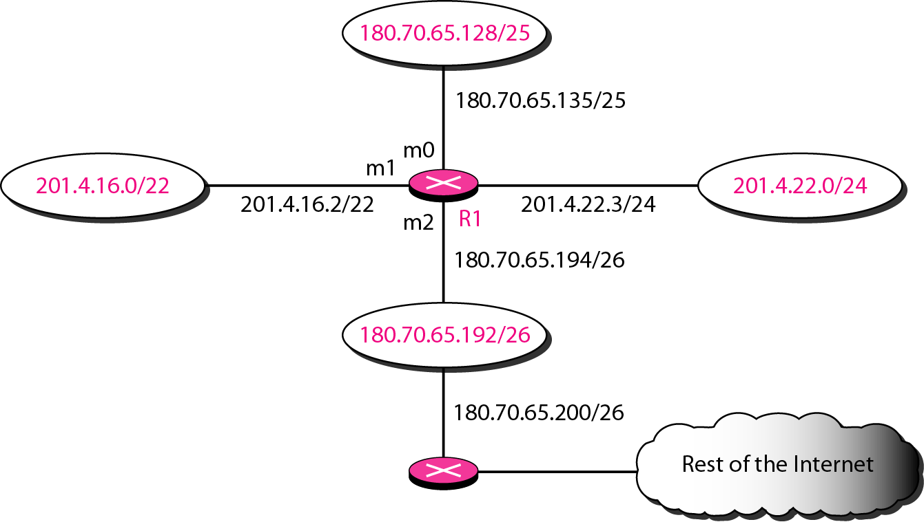
Figure 22.6 Configuration for Example 22.1

Slide 5
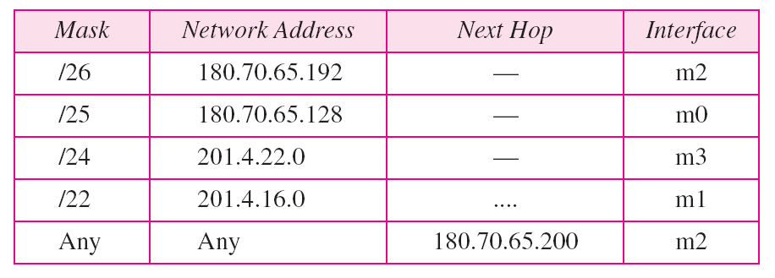
Table 22.1 Routing table for router R1 in Figure 22.6

Slide 6
Example 22.2
Show the forwarding process if a packet arrives at R1 in Figure 22.6 with the destination address 180.70.65.140.
Solution
The router performs the following steps:
1. The first mask (/26) is applied to the destination address. The result is 180.70.65.128, which does not match the corresponding network address.
2. The second mask (/25) is applied to the destination address. The result is 180.70.65.128, which matches the corresponding network address. The next-hop address and the interface number m0 are passed to ARP for further processing.

Slide 7
Example 22.3
Show the forwarding process if a packet arrives at R1 in Figure 22.6 with the destination address 201.4.22.35.
Solution
The router performs the following steps:
1. The first mask (/26) is applied to the destination address. The result is 201.4.22.0, which does not match the corresponding network address.
2. The second mask (/25) is applied to the destination address. The result is 201.4.22.0, which does not match the corresponding network address (row 2).

Slide 8
Example 22.3 (continued)
3. The third mask (/24) is applied to the destination address. The result is 201.4.22.0, which matches the corresponding network address. The destination address of the packet and the interface number m3 are passed to ARP.

Slide 9
Example 22.4
Show the forwarding process if a packet arrives at R1 in Figure 22.6 with the destination address 18.24.32.78.
Solution
This time all masks are applied, one by one, to the destination address, but no matching network address is found. When it reaches the end of the table, the module gives the next-hop address 180.70.65.200 and interface number m2 to ARP. This is probably an outgoing package that needs to be sent, via the default router, to someplace else in the Internet.

Slide 10
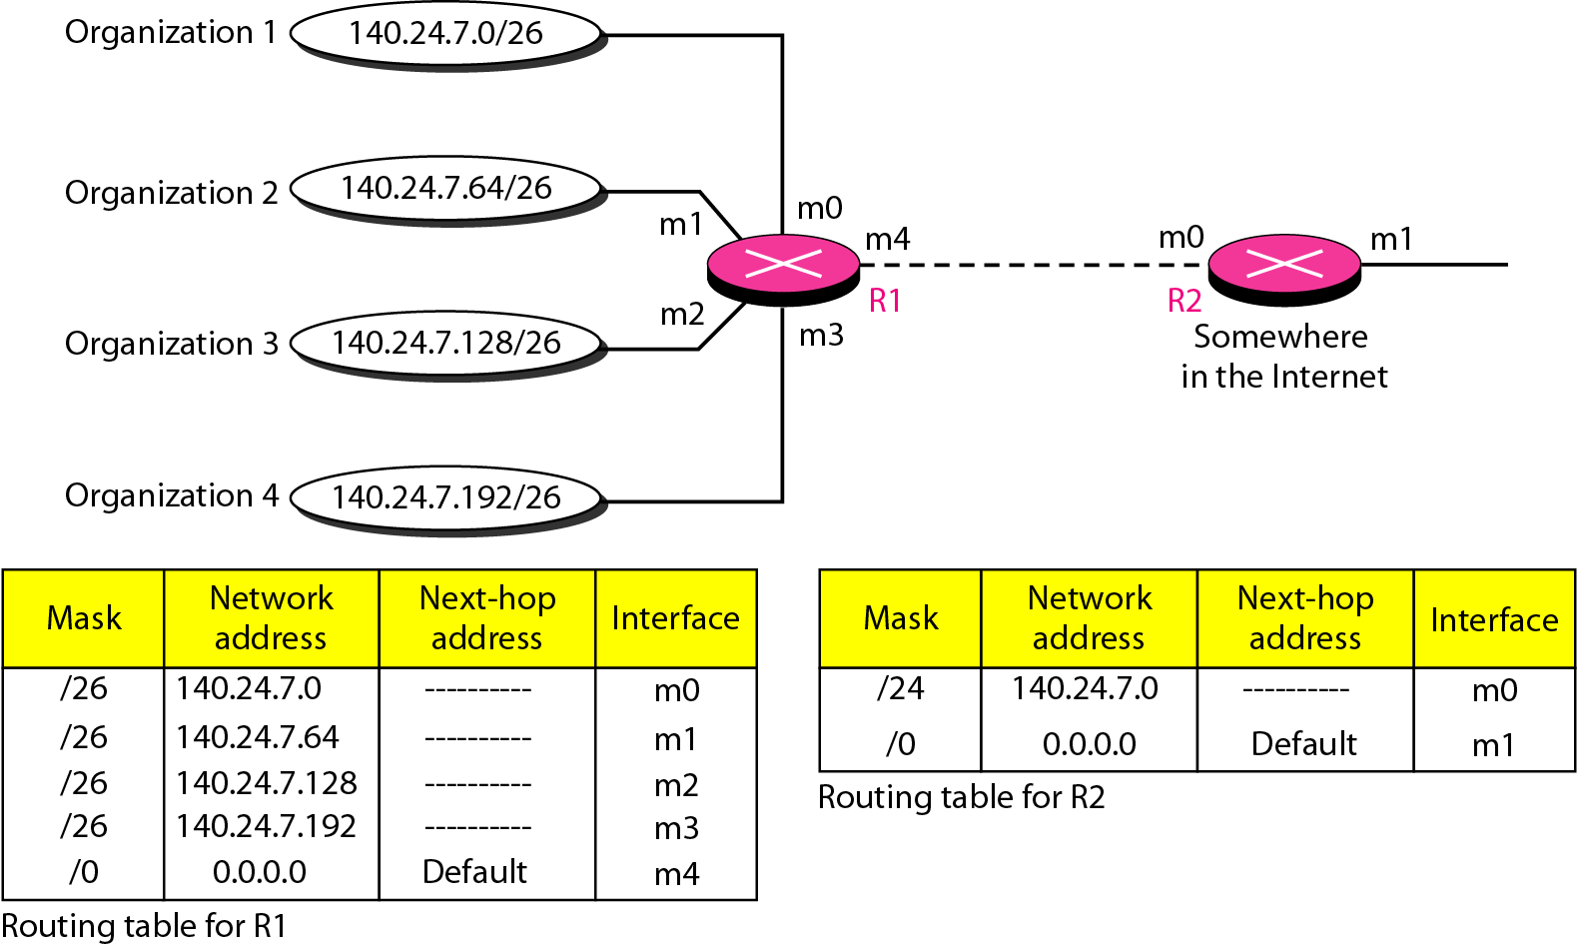
Address aggregation
Forwarding table need not include all the host /subnet addresses.

Slide 11
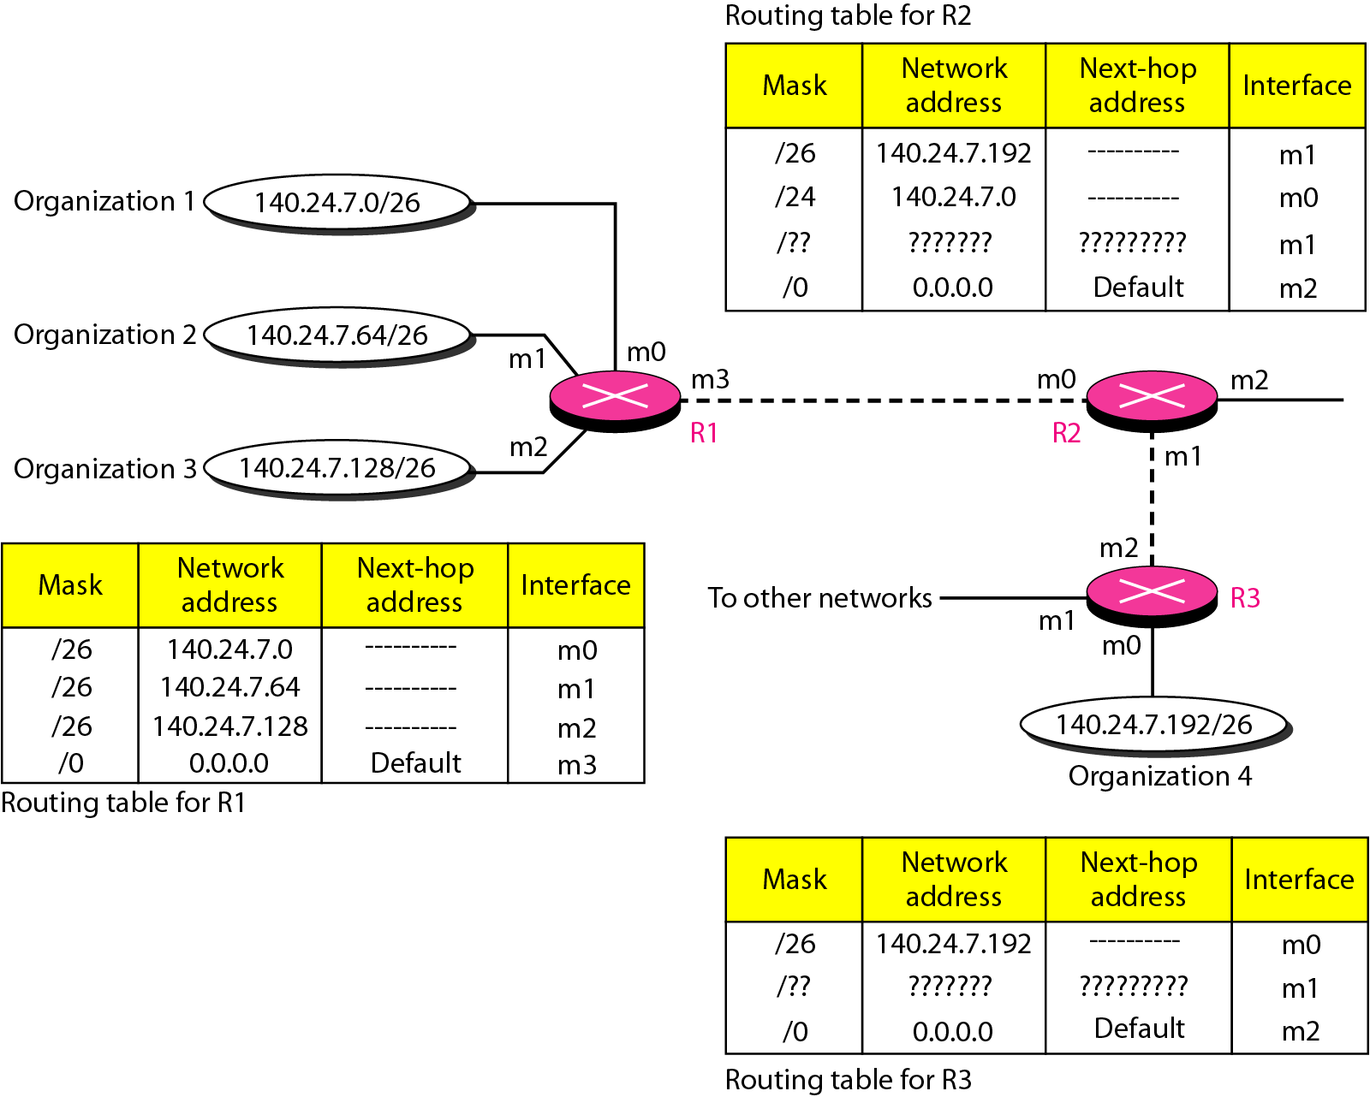
Figure 22.8 Longest mask matching

